Slide 1
ThermoTilt -Project Semester 2-
By: Robert Walsh

Slide 2
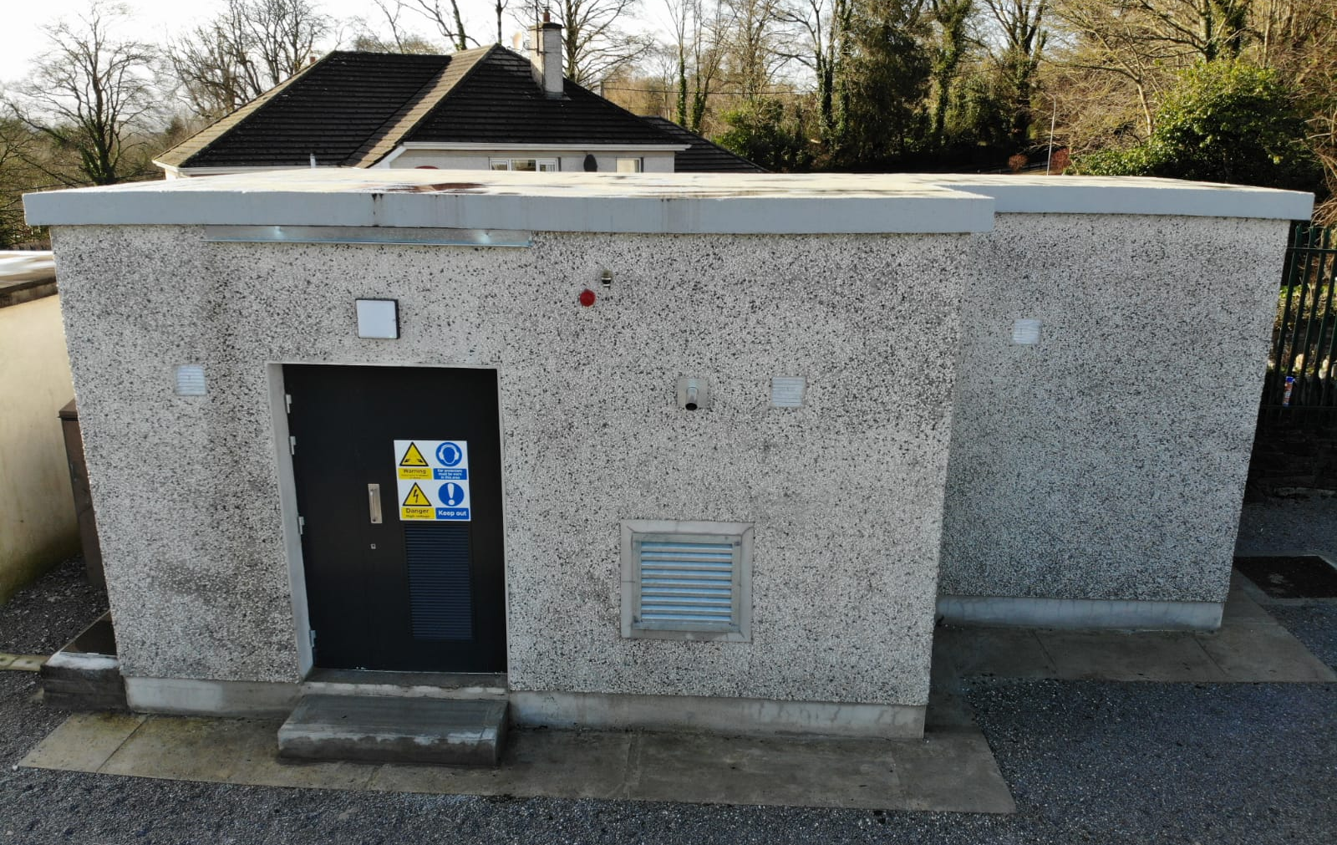

Slide 3
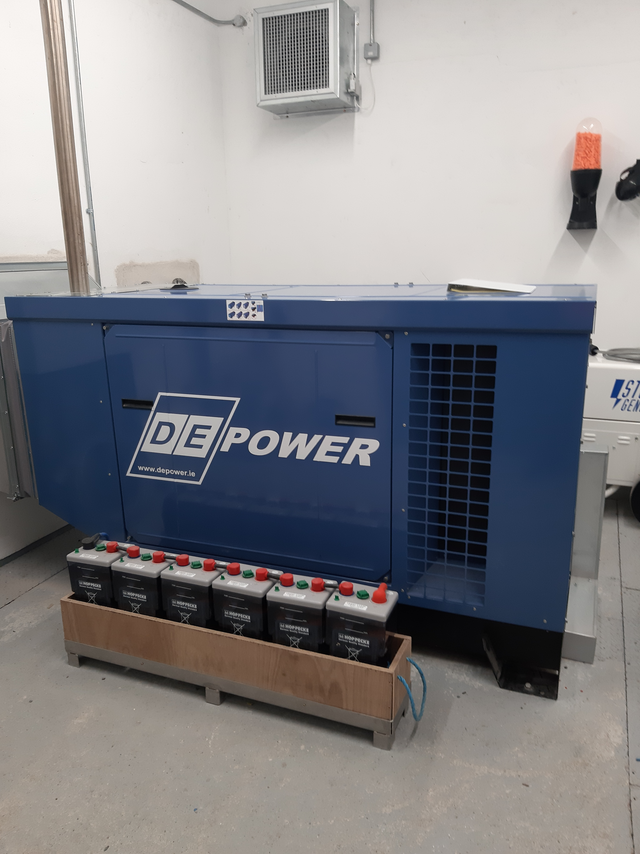

Slide 4
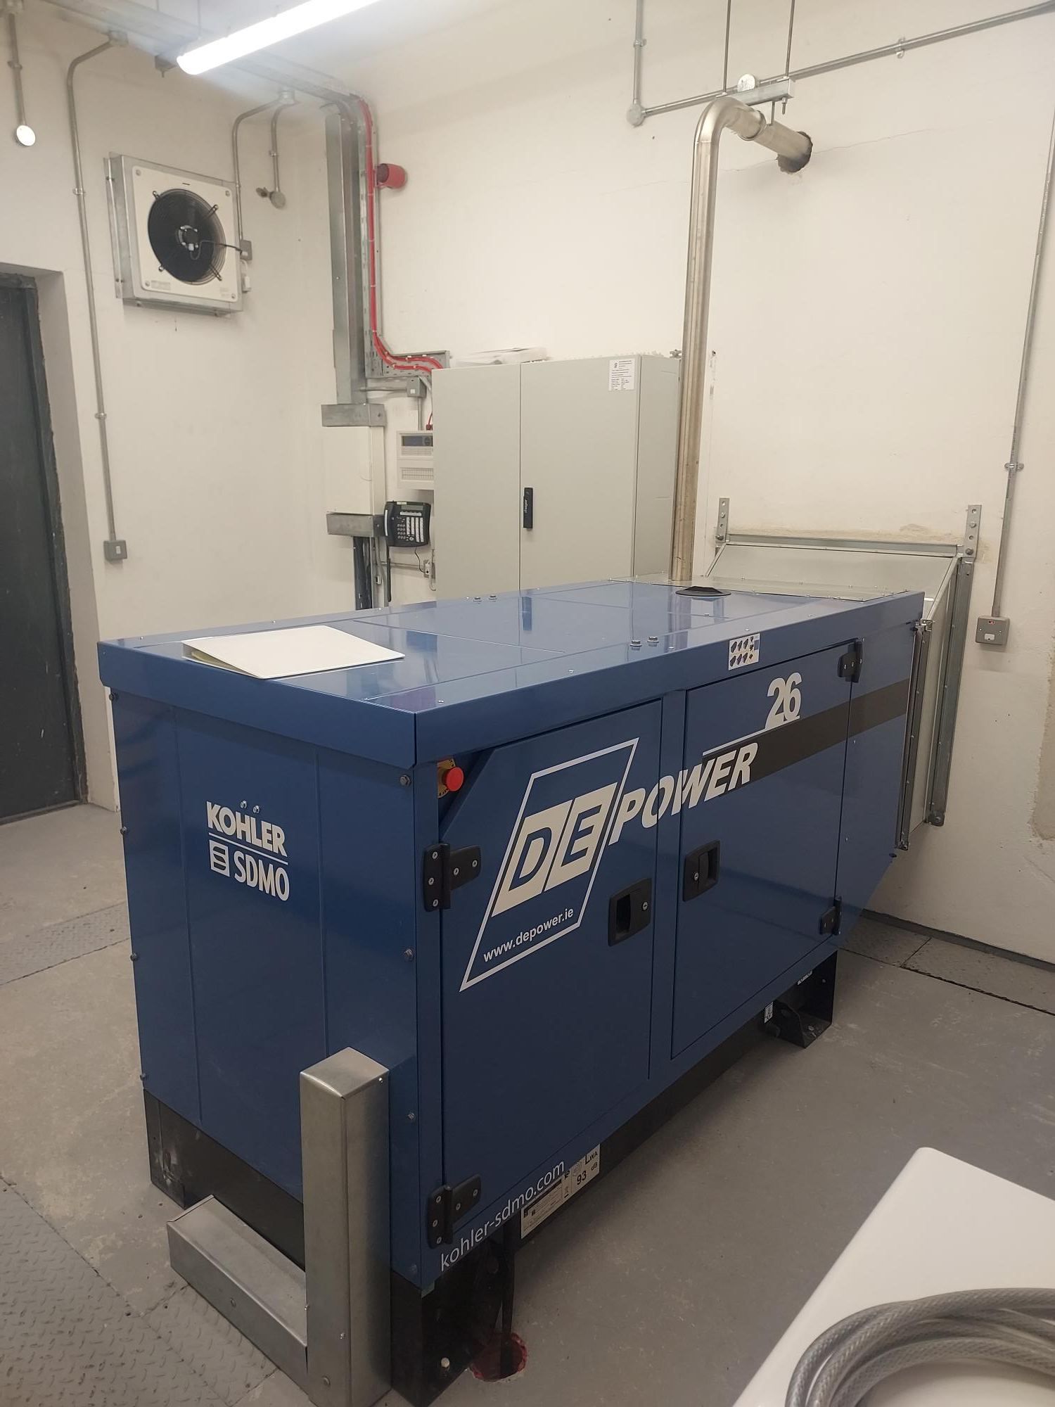

Slide 5
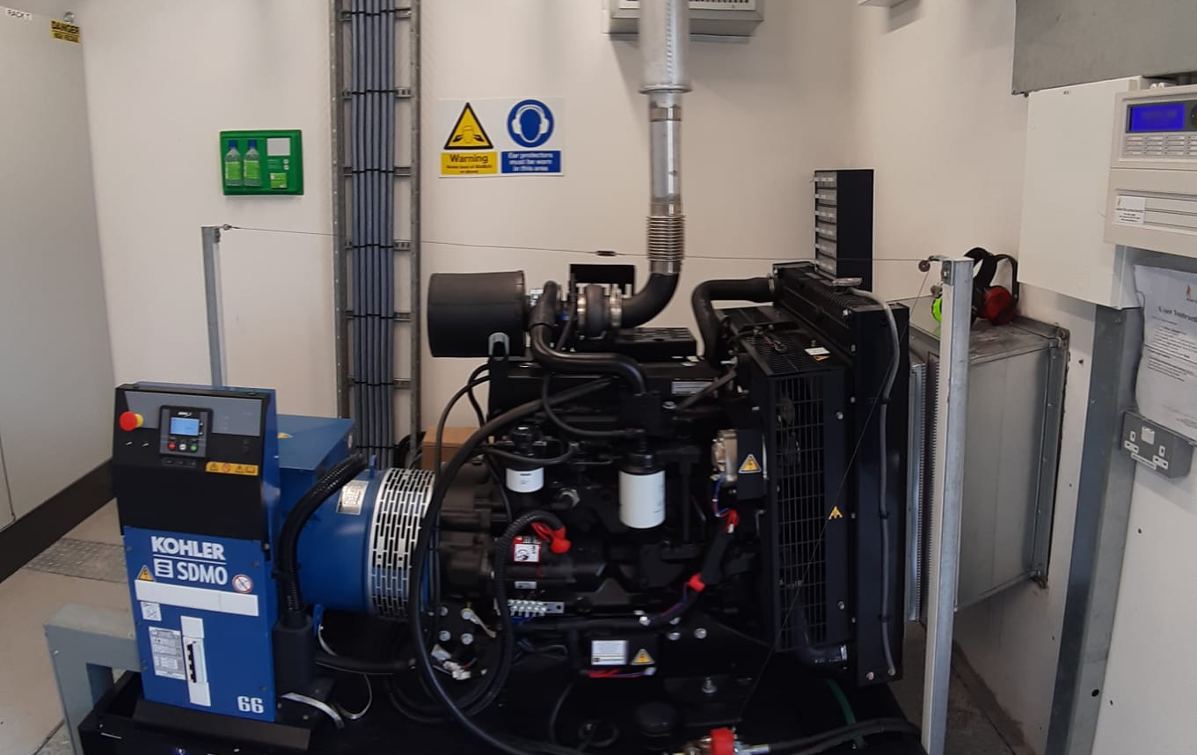

Slide 6
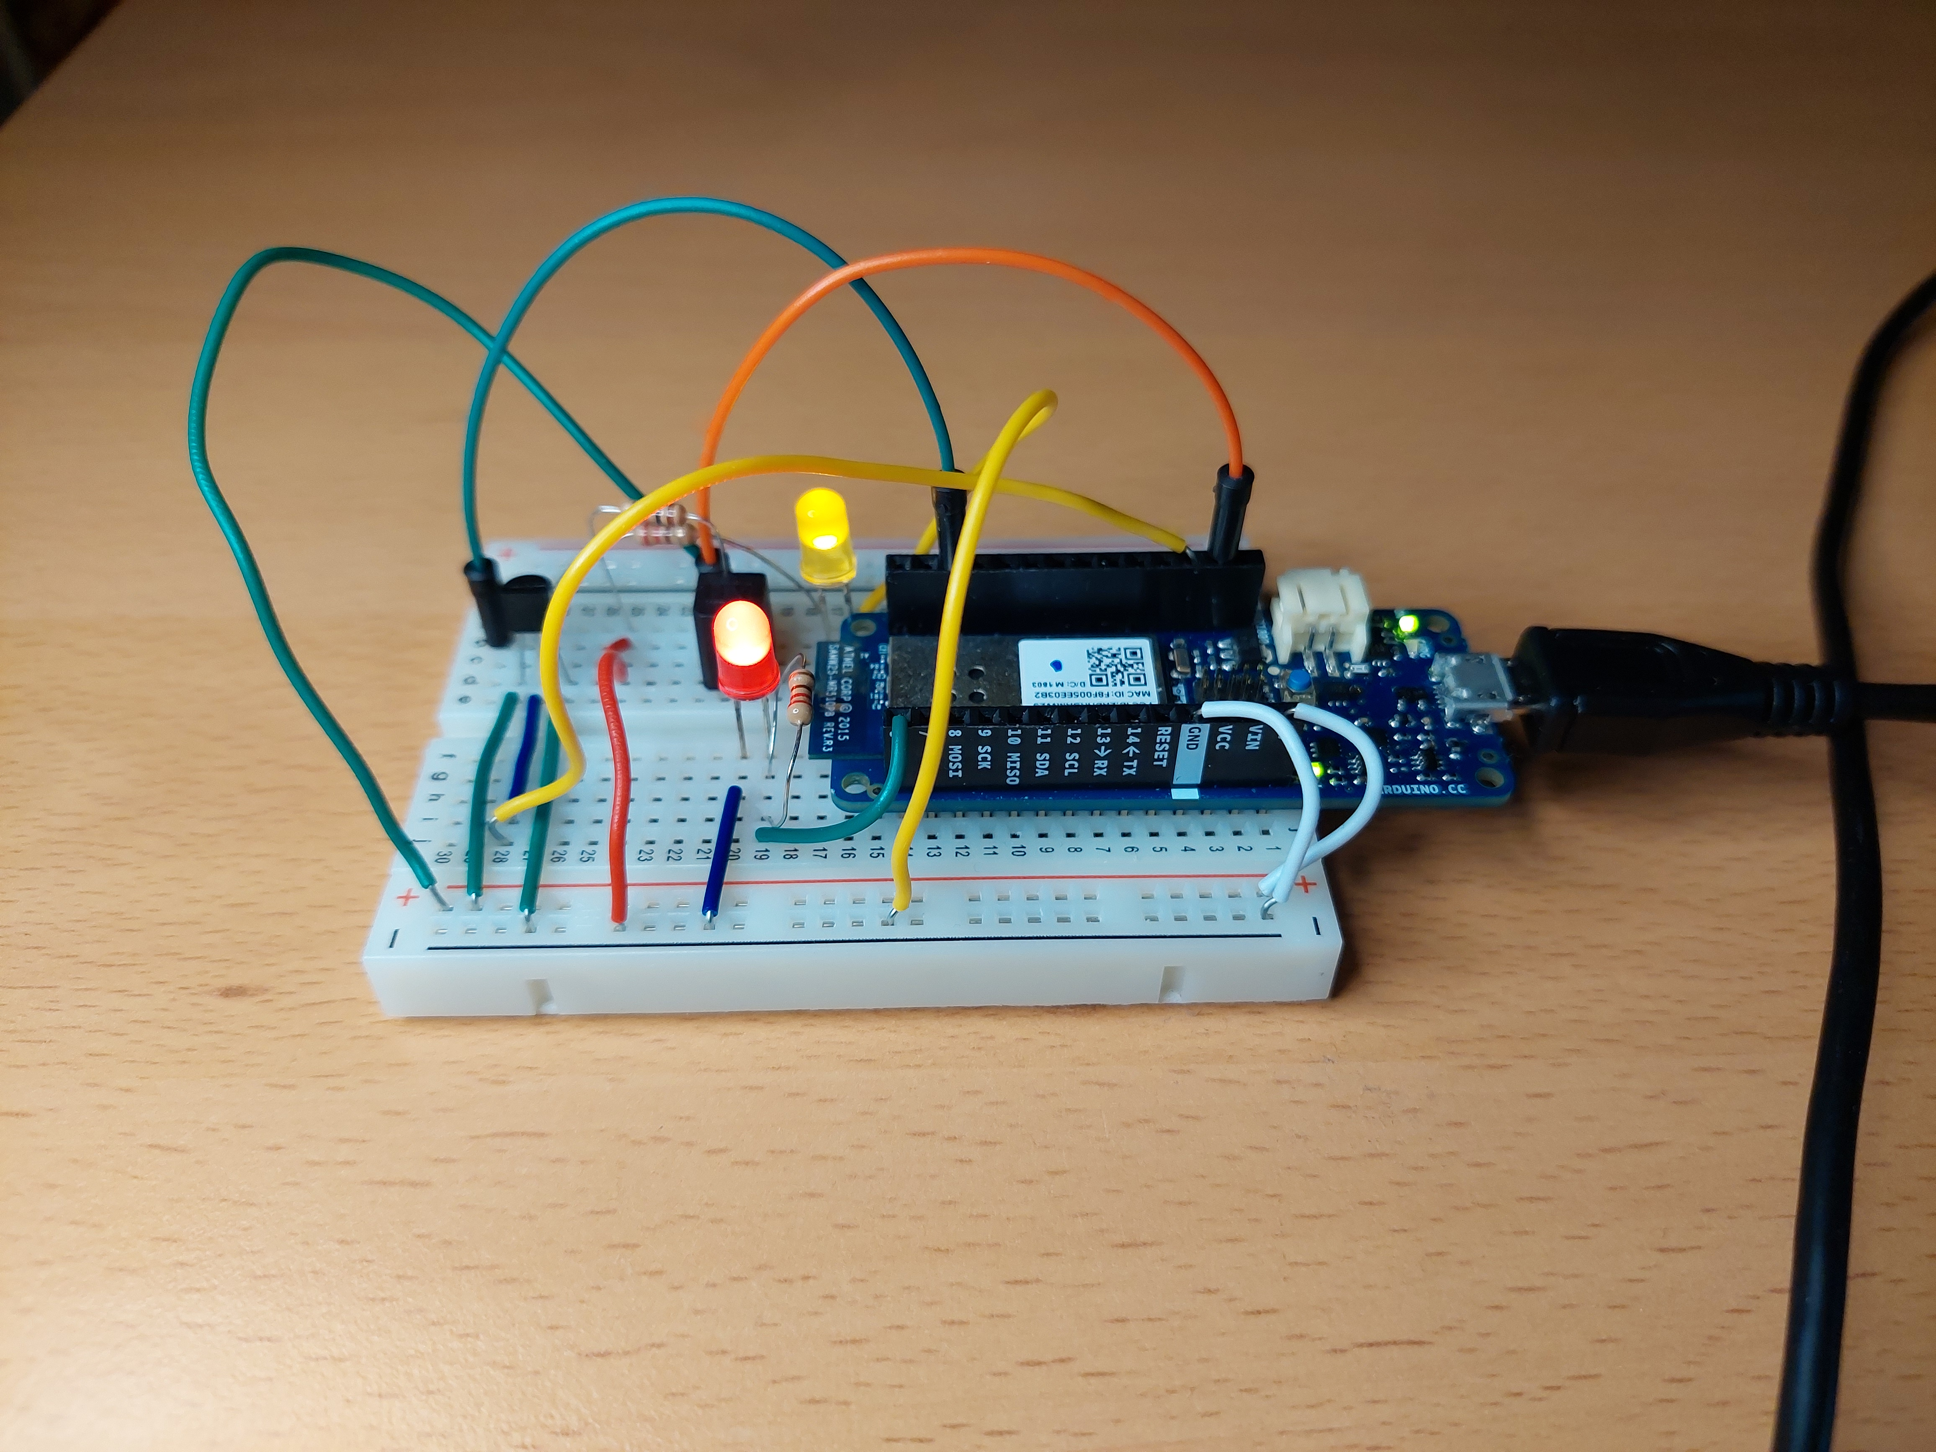
What I’ve Made
Arduino MKR1000
Tilt Sensor
TMP36 Temperature Sensor
Red/Yellow LEDs
C/C++
Arduino IoT Cloud

Slide 7
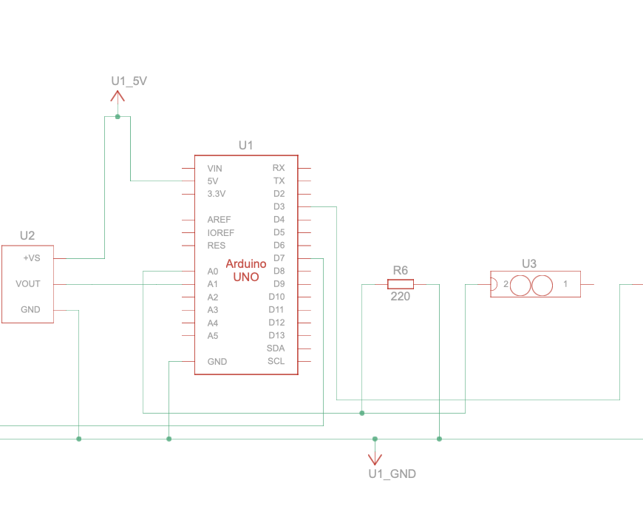
Extra Materials
Video Demonstration
Circuit Schematic
Read Me

Slide 8


Minor Fault v Major Fault
Minor Fault
Major Fault
⚠️ Possible Emergency Inbound!
🚨 EMERGENCY!

Slide 9
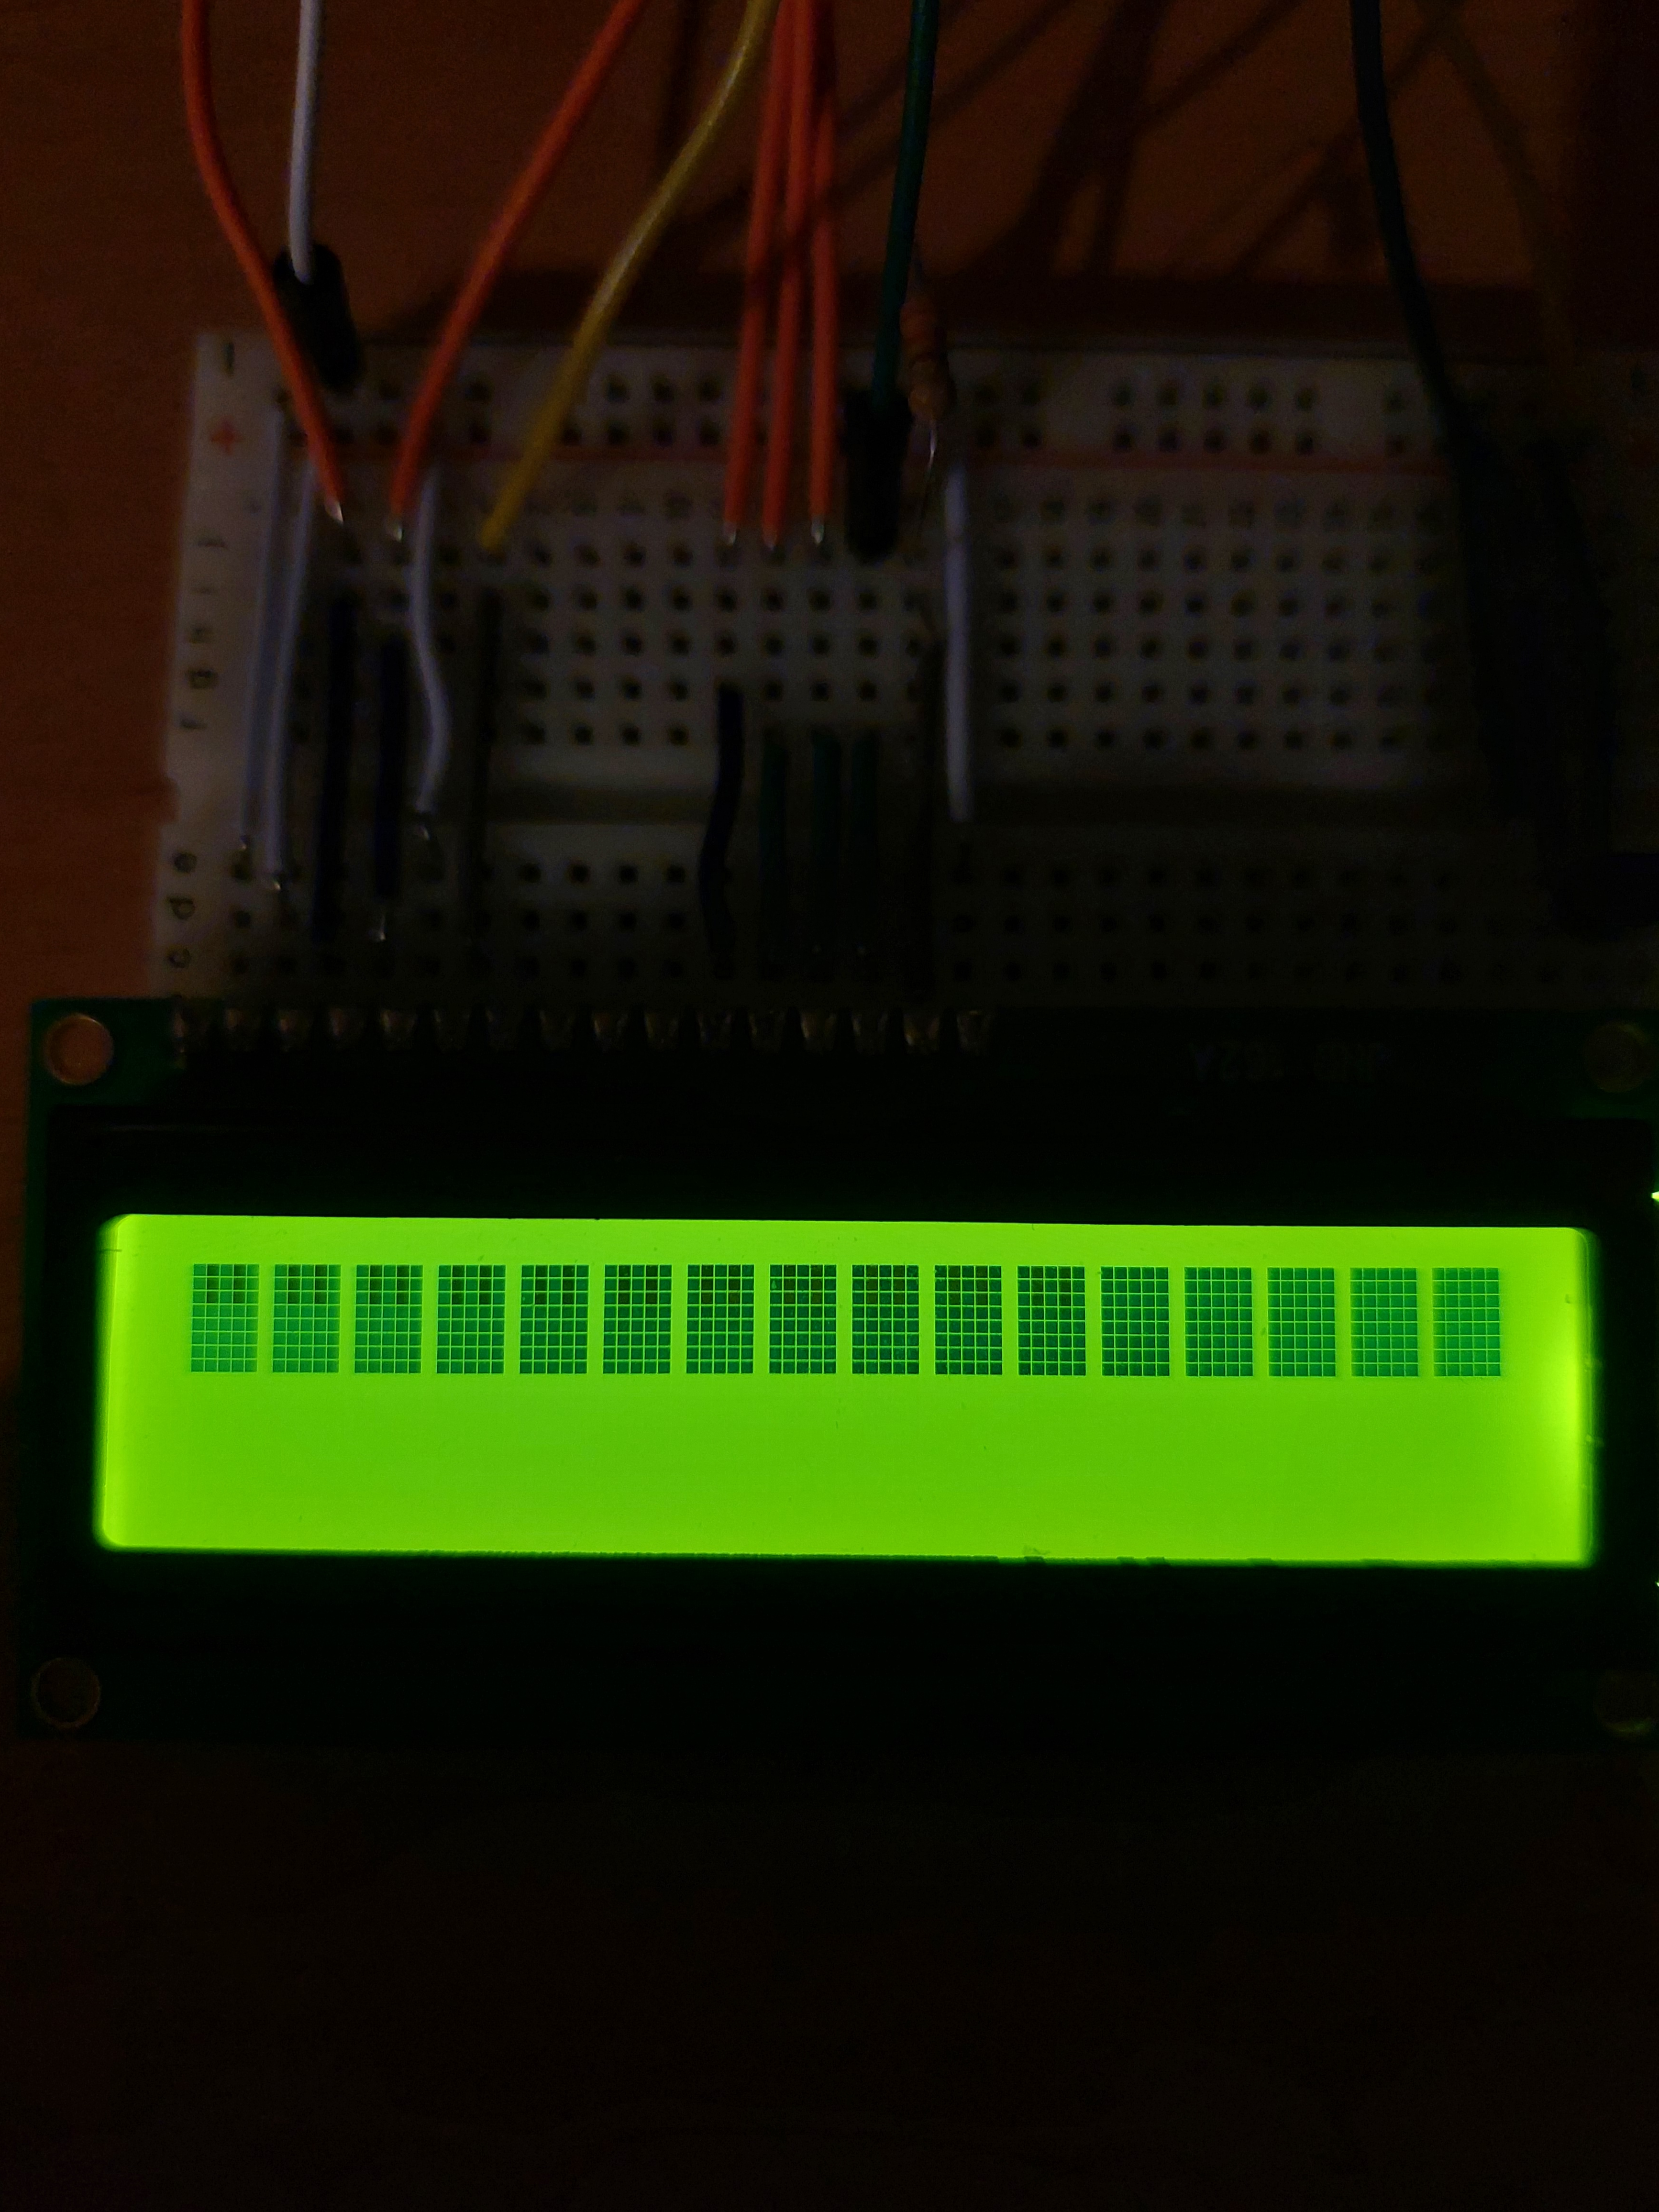
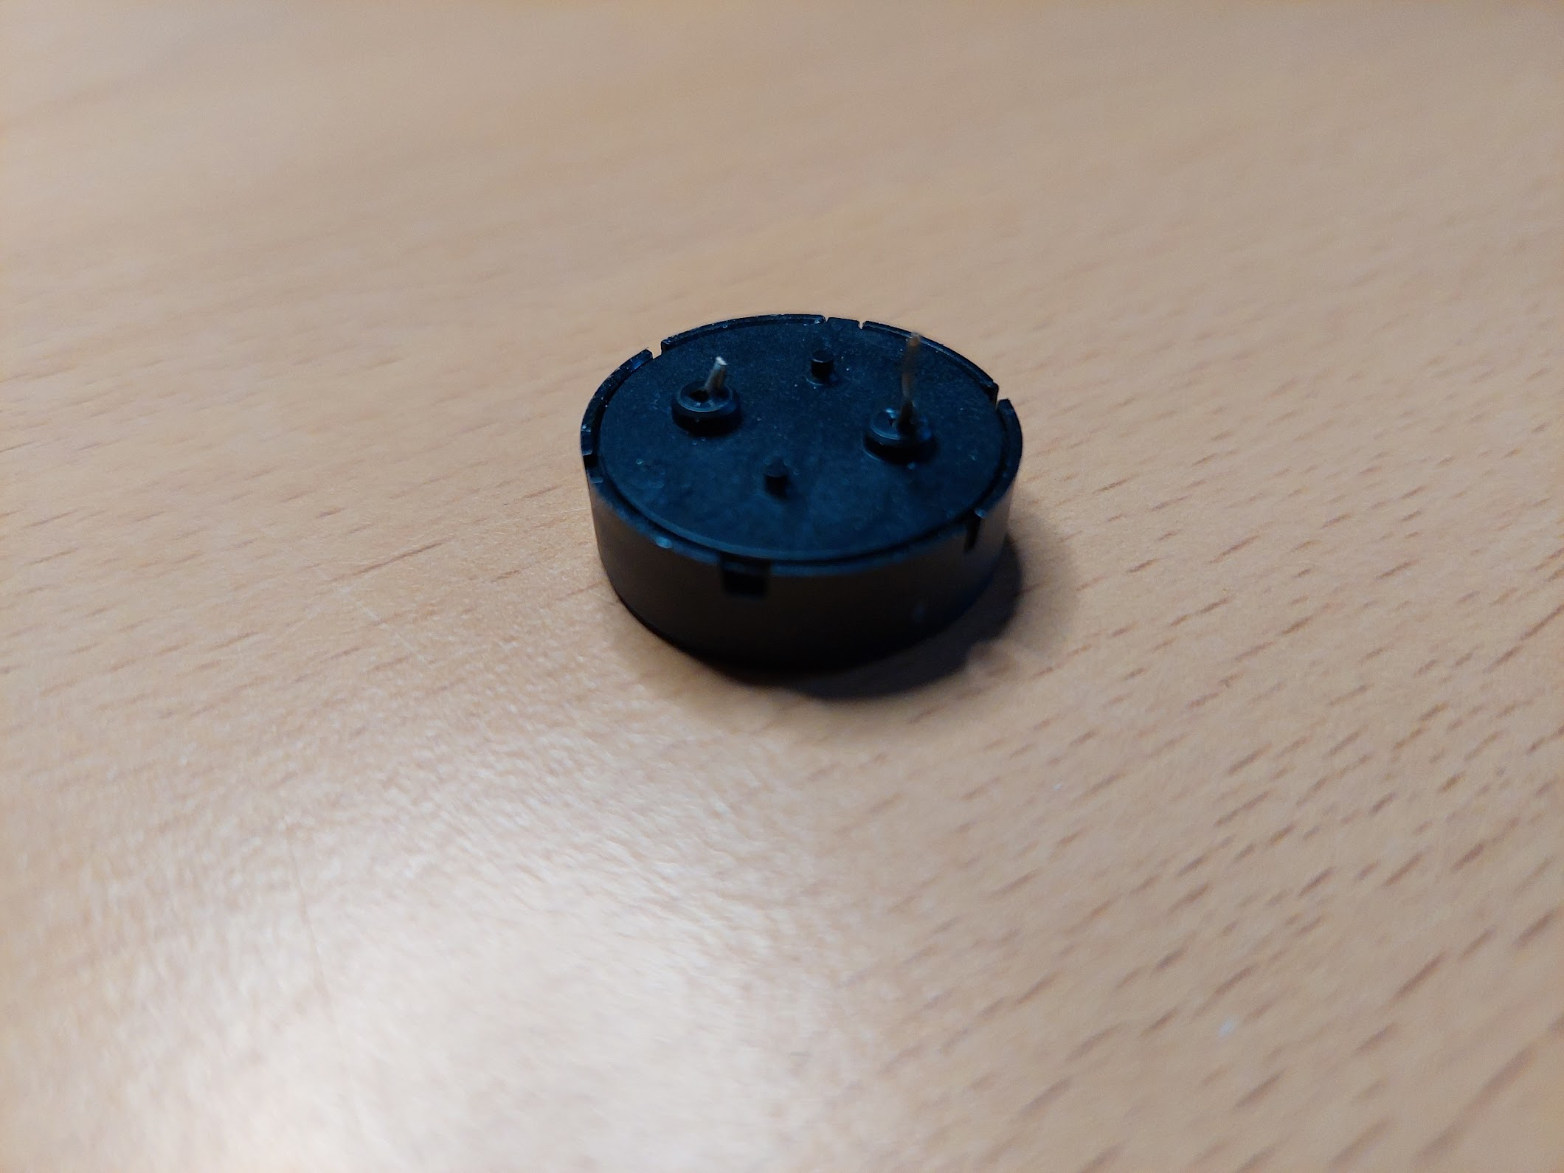

Issues
Broken Leg ☹

Slide 10
Thank You!
Any questions?

